Slide 1
Predicting Stock Prices using Time Series, LSTM, and FBProphet
By Anthony Chau

Slide 2
Introduction
For the final project I will be using concepts learned in the final section of this course. I will utilize ARIMA, LSTM, and FBProphet in order to predict GOOGL and SPY(S&P500) as accurately as I am able to.
These methods stem from 3 different concepts inside machine learning/forecasting but they all work toward a common outcome of predicting an uneven time series with uncanny accuracy.
We will employ a gamut of time series concepts along with helpful graphs to illustrate our work.

Slide 3
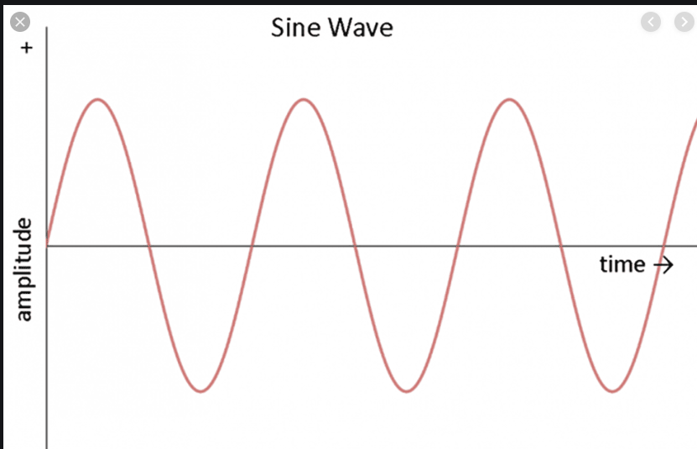
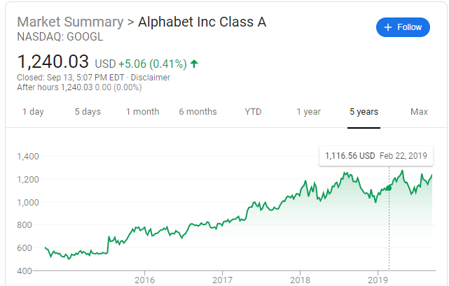
ARIMA
ARIMA - Autoregressive Integrated Moving Average
As evident, the sine wave is very easy to predict because it has constant mean and variance throughout. However, GOOGL stock on the right is extremely difficult to predict due to it’s unpredictability and variability.
ARIMA methods can account for these inconsistencies and predict these types of series.

Slide 4
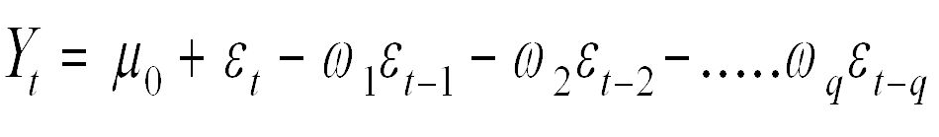
ARIMA
AR - Value of Series Y at time T is a function of it’s values in previous time steps plus an error term e. This is an Autoregressive term.
MA - Value of Series Y at time T is a function of it’s errors in previous time steps. This is a moving average term.

Slide 5
Stationarity and Nonstationarity
Nonstationarity series do not have a constant mean and variance. If series are nonstationarity, they can be made stationarity through differencing, also known as integration.
Stationarity can be checked for using the Augmented Dickey Fuller test which tests for a unit root.

Slide 6
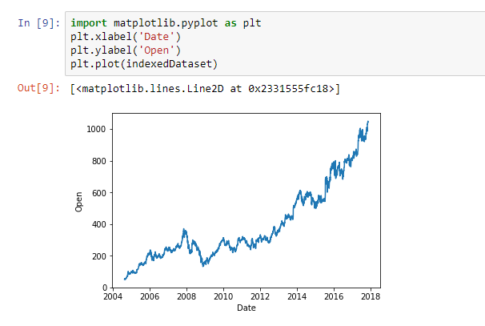
ARIMA
As we can tell, GOOGL chart looks nonstationary, it surges over time.

Slide 7
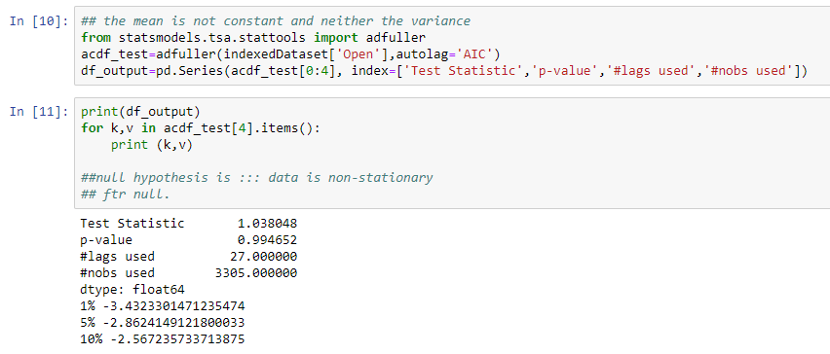
ARIMA - Test of nonstationarity
The ADF test proves that series is nonstationarity. The p value is 0.99, therefore we fail to reject the null hypothesis.

Slide 8
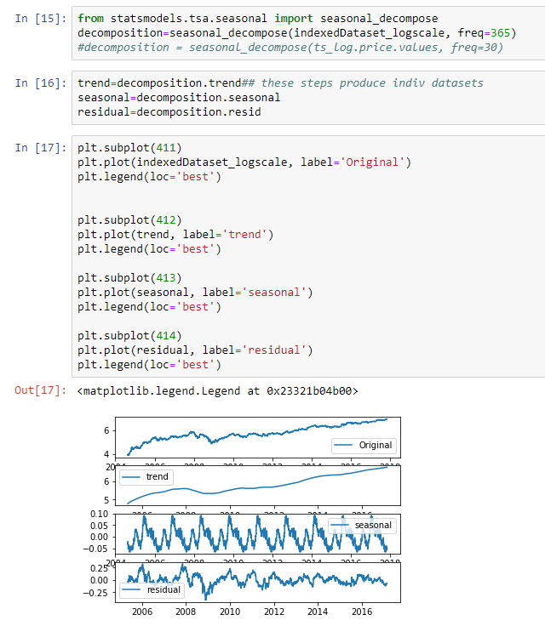
The original and the trend looks almost identical. The seasonality chart shows some seasonality but not too strong to effect the trend.

Slide 9
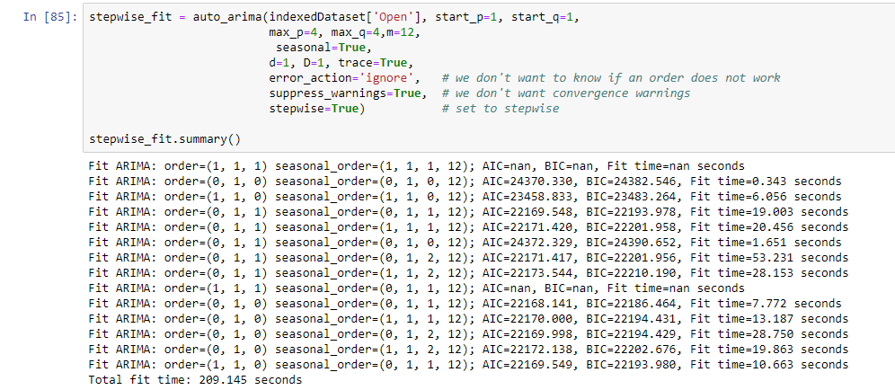
Prediction
PMD ARIMA chooses SARIMAX(0, 1, 0)x(0, 1, 1, 12) as the best model based on the lowest AIC value.

Slide 10
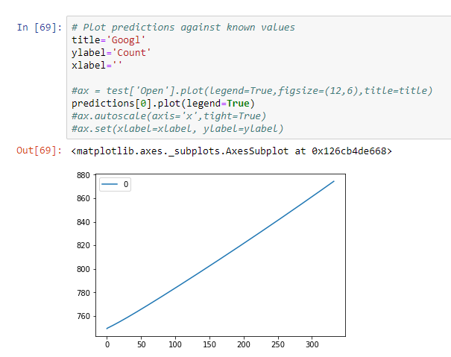
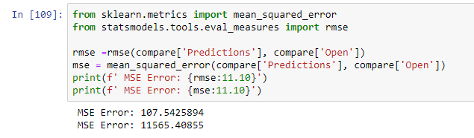
Prediction
SARIMA method does not do a good job predicting stock prices. It just predicts a linear line that does not seem to mimic Google prices.
As expected the MSE is rather large due to poor predictive power of the time series method

Slide 11
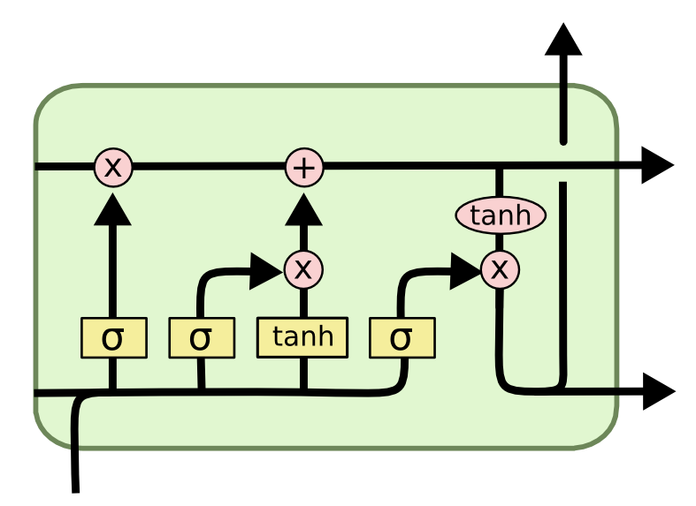
LSTM
Long Short Term Memory is a popular method in predicting day ahead prices, it follows deep learning methods using a cell state and input and forget gates.
The top horizontal arrow represents the cell state which is the long term trend of the series. The leftmost sigmoid outputs a number between 0 and 1. 1 represents completely keep and 0 means to completely forget. The next step is to decide what new information we’re going to store in the cell state. This has two parts. First, a sigmoid layer called the “input gate layer” decides which values we’ll update. Next, a tanh layer creates a vector of new candidate values, that could be added to the state.

Slide 12
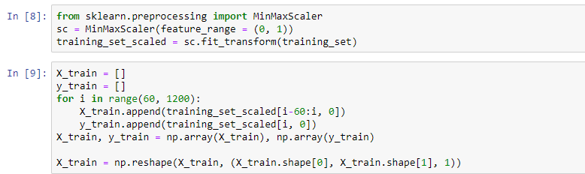
LSTM
Using 60 time steps to predict the 61st value.
Data is min maxed scaled

Slide 13
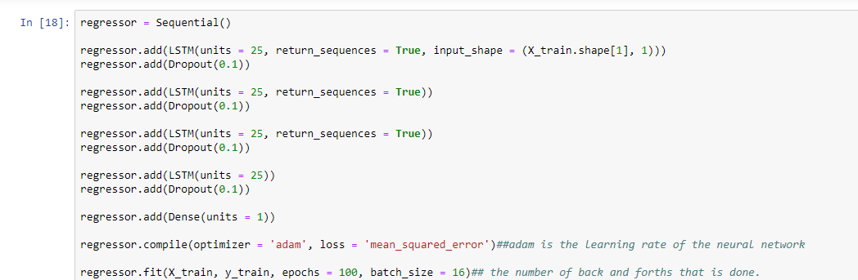
Model Structure
Used 25 units, dropout rate of 10%, MSE as loss 100 epochs
Loss reduce gradually with every epoch

Slide 14
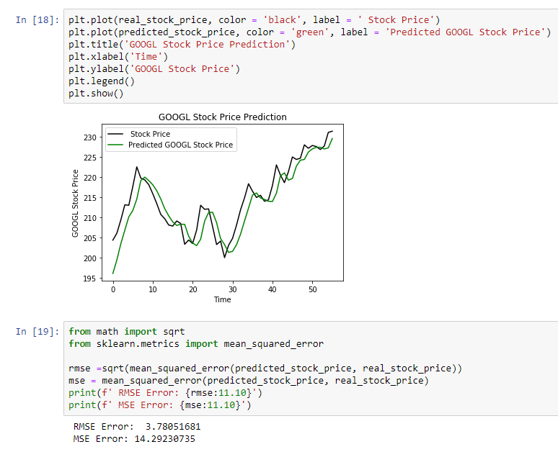
Prediction
LSTM is able to mimic Google prices with a fair amount of accuracy. The (RMSE) root means square error is 3.7.

Slide 15
FBProphet
FBProphet is a forecasting technique invented by Facebook. According to the https://research.fb.com/prophet-forecasting-at-scale/, the Prophet procedure is an additive regression model with four main components:
A piecewise linear or logistic growth curve trend. Prophet automatically detects changes in trends by selecting changepoints from the data.
A yearly seasonal component modeled using Fourier series.
A weekly seasonal component using dummy variables.
A user-provided list of important holidays.

Slide 16
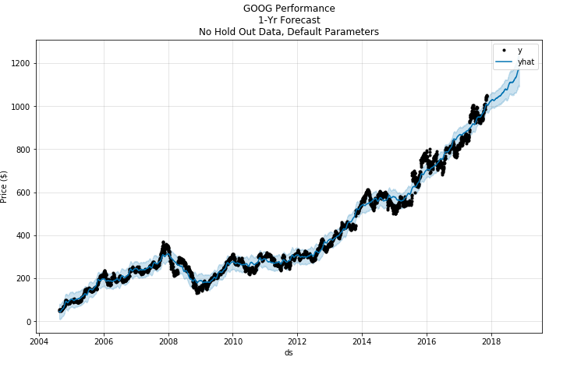
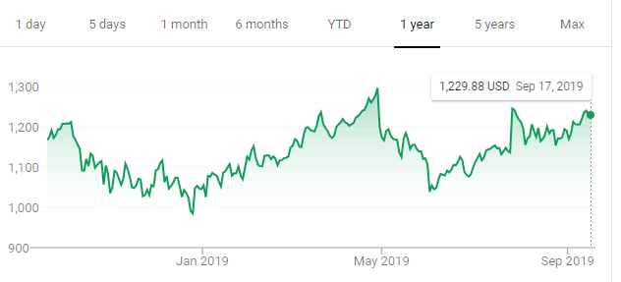
FB Prophet Forecast
FBProphet seems to catch the trend fairly well
According to this, Google’s stock was expected to hit somewhere around $1200 by Nov 2018.
Google did hit $1200 around Sept but entire market crashed after Oct in 2018 which FB Prophet could not predict for obvious reasons.
If it weren’t for the market crash, Prophets seems to predict with a fair amount of accuracy even 1 year out.

Slide 17
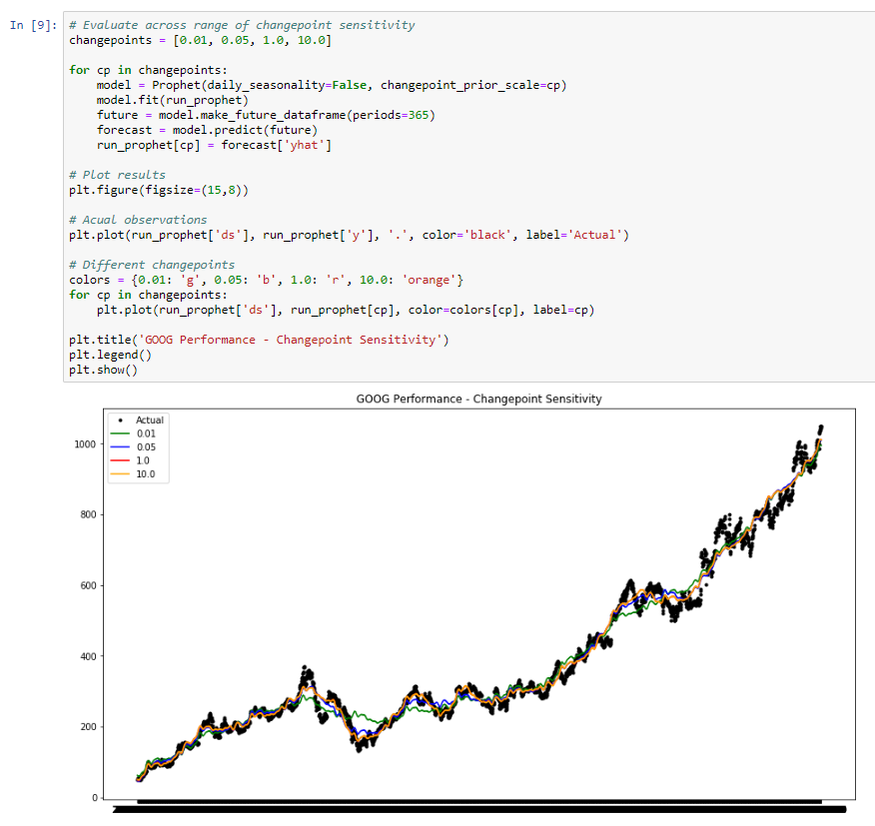
FB Prophet Forecast
One of the options in Prophet is change point sensitivity. Smaller values make it less flexible and vice versa. Change point of 0.05 seems to predict the model most accurately.

Slide 18
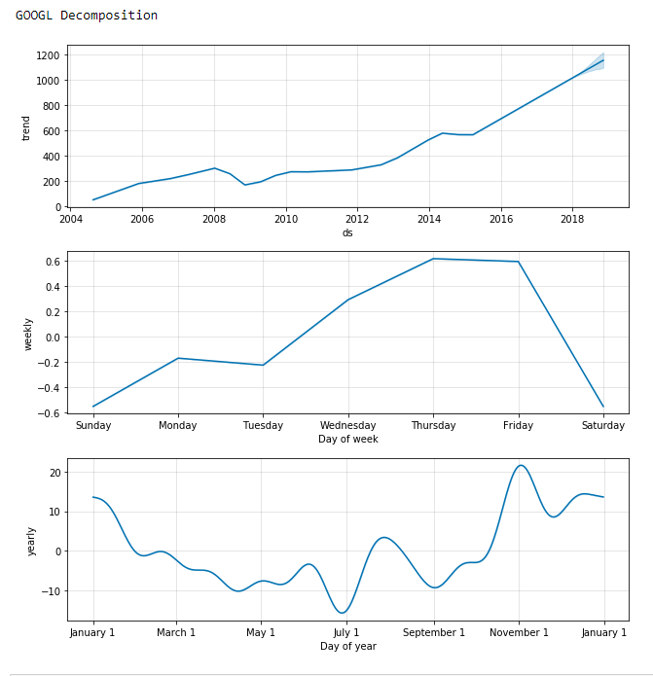
Seasonal Decomposition
Prophet picks up on the trend and the confidence interval is pretty narrow.
Seasonality does not seem to be consistent.

Slide 19
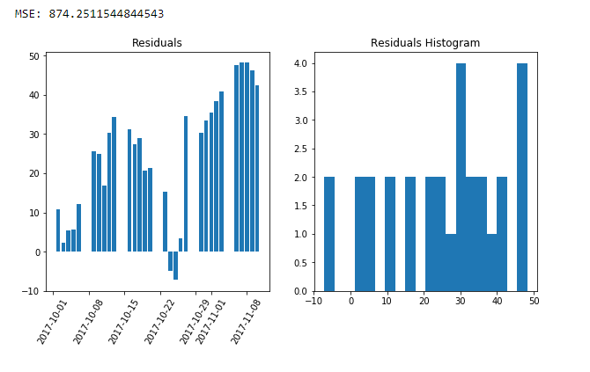
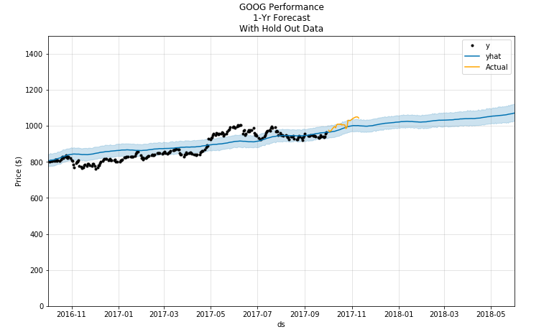
Train/Test Validation
The train/test validation is fairly accurate MSE of 874, and RMSE of 29.5 and residuals are slightly overstated.

Slide 20
Conclusion
LSTM and FB Prophet were pretty accurate in predicting stock prices for Google.
I use LSTM to only predict 1 day ahead prices. Therefore the errors were quite low.
Fb Prophet was able to predict with a fair amount of accuracy prices well into the future.

